Slide 1
Topic 4.2 Understanding Computer Hardware
C851 Cohort Live Session for Sunday, October 10, 2021
Dr. John S. Galliano | C851 Linux Foundations Instructor

Slide 2
Agenda
Welcome
Lecture
Demos
About the Exam
The 5 Exam Domains
Wrap-Up

Slide 3

About the Linux Essentials v1.6 [1]
The 5 Exam Domains [3]
No prerequisites
Closed book, up to 60 minutes
40 multiple-choice (some multi-select and fill-in-the-blank items) questions
Min pass score 500 points (200-800 scale)
Partially correct responses not accepted (for F-I-T-B questions LPI may accept multiple correct versions of an answer [2]
Total exam weight count is 40, thus 40 questions
The Linux Community and a Career in Open Source
Finding Your Way on a Linux System
The Power of the Command Line
The Linux Operating System
Security and File Permissions
[1,3] Linux Professional Institute, “Linux Professional Institute Linux Essentials,” Linux Professional Institute, 21-Oct-2018. [Online]. Available: https://www.lpi.org/our-certifications/linux-essentials-overview. [Accessed: 14-Aug-2021]
[2] Dr. Galliano’s correspondence with LPI, dated August 2021: Example: with/without leading path in a case where the answer is a command
Notes:
Examples:
• If an objective has a weight of 4, there will be 4 questions on the exam related to that objective [2]
Links:
• View the 3rd party cert tips video at https://bit.ly/3party_cert_tips

Slide 4

LPI Exam Re-Take Policy [4]
Anyone who takes an LPI exam once must wait one week before re-taking
Anyone who takes an LPI exam a second (and subsequent) time must wait 30 days before re-taking
3rd and subsequent attempts at your own cost ($120)
[4] Linux Professional Institute, “Privacy Statement and Policies,” Linux Professional Institute, 18-May-2018. [Online]. Available: https://www.lpi.org/policies. [Accessed: 14-Aug-2021].
Notes:
• Anyone who passes an LPI exam may not retake that exam for two years

Slide 5

Exam Topics/Weightings
Linux Essentials v1.6 Exam Topics [5] | 1.1 | 2
 | 1.2 | 2
 | 1.3 | 1
 | 1.4 | 2
 | 2.1 | 3
 | 2.2 | 2
 | 2.3 | 2
 | 2.4 | 2
 | 3.1 | 2
 | 3.2 | 3
 | 3.3 | 4
 | 4.1 | 1
 | 4.2 | 2
 | 4.3 | 3
 | 4.4 | 2
 | 5.1 | 2
 | 5.2 | 2
 | 5.3 | 2
 | 5.4 | 1
 |  | 40
[5] Linux Professional Institute, “Linux Essentials Objectives V1.6 - LPI Wiki,” Linux Professional Institute, 25-Jan-2020. [Online]. Available: https://wiki.lpi.org/wiki/Linux_Essentials_Objectives_V1.6. [Accessed: 14-Aug-2021].
Notes:
• A weight of “1” equates to 1 exam question
• Since there is a weight of ‘2’, you will see 2 questions on this topic!

Slide 6

4.2 Understanding Computer Hardware [6]
Weight: 2 (2 questions)
Description:
Familiarity with the components that go into building desktop/server computers
Key Knowledge Areas:
Hardware
Files used, terms and utilities:
Motherboards, processors, power supplies, optical drives, peripherals
Hard drives, solid state disks and partitions, /dev/sd*
Drivers
[6] Linux Professional Institute (LPI), “Exam 010 Objectives,” Linux Professional Institute, 21-Oct-2018. [Online]. Available: https://www.lpi.org/our-certifications/exam-010-objectives. [Accessed: 10-Jul-2021].
Notes:
What to Know:
• Learning about your CPU
• Identifying motherboard capabilities
• Sizing your power supply
• Understanding disk issues
• Managing displays
• Handling USB devices
• Managing drivers
Commands (‘#’ denotes a comment):
• None
Links:
• https://explainshell.com/ to learn about commands, options, arguments
• https://github.com/g33k247/851 for Dr. Galliano’s GitHub repo of study resources

Slide 7
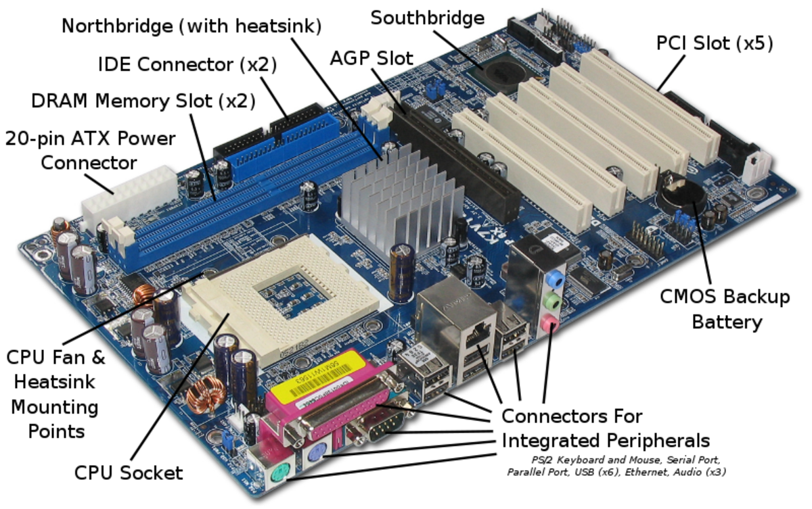
Identifying Motherboard Capabilities
[7] Wikimedia, “Labelled Motherboard,” wikimedia.org. [Online]. Available: https://upload.wikimedia.org/wikipedia/commons/f/f7/ ASRock_K7VT4A_Pro_Mainboard_Labeled_English.svg. [Accessed: 09-Oct-2021]

Slide 8
Learning About Your CPU
Understanding CPU Families
x86
x86-64
ARM
Identifying Your CPU
uname -a
lscpu
cat /proc/cpuinfo
Notes:
What to Know:
• Learning about your CPU
• Identifying motherboard capabilities
• Sizing your power supply
• Understanding disk issues
• Managing displays
• Handling USB devices
• Managing drivers
Commands (‘#’ denotes a comment):
• uname –a
• lscpu
• lspci
• cat /proc/cpuinfo
Links:

Slide 9
Sizing Your Power Supply
AC to DC power conversion
Internal vs. External Power Supplies
Output Rating and Installed Components

Slide 10
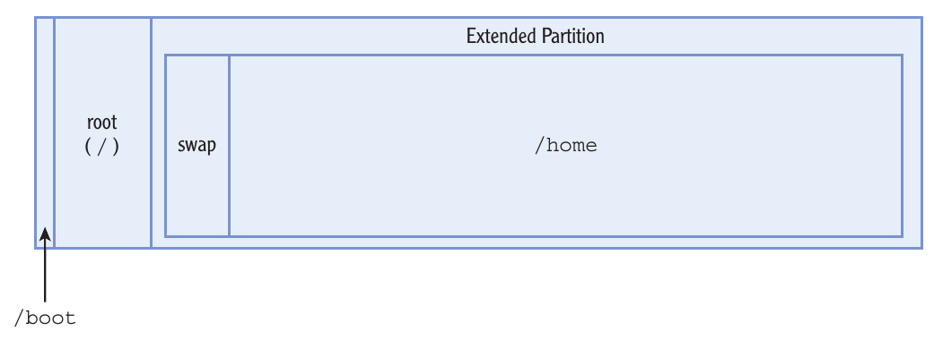
Understanding Disks, Partitions, and Volumes
Disk Interfaces (pata, sata)
Partitioning a Disk
Master Boot Record (MBR)
a.k.a., MS-DOS or BIOS
Now GUID Partition Table (GPT)
MBR Partition Types:
Primary
Extended
Logical

Slide 11
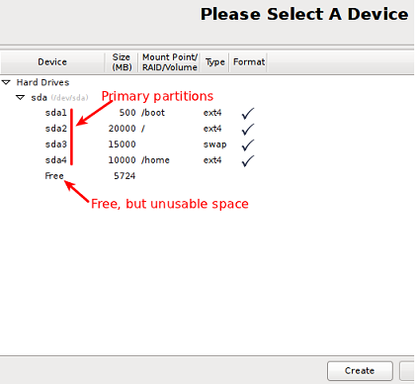
Understanding Disks, Partitions, and Volumes
Partitioning Software Families
fdisk
libparted
GPT fdisk
Linux disk device filenames
dev/fd1 - second floppy drive
dev/sda - first SCSI disk SCSI ID address-wise
dev/sdb - second SCSI disk address-wise and so on
dev/scd0 or /dev/sr0 - first SCSI CD-ROM
dev/hda - primary disk on IDE primary controller

Slide 12
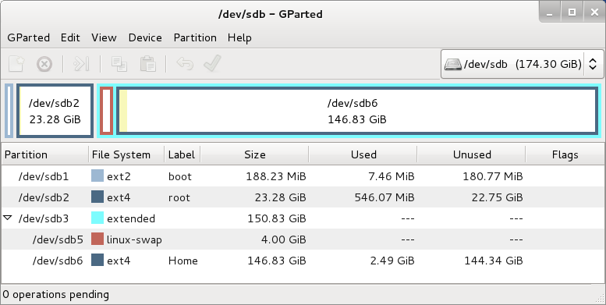
Partitioning a Disk Using GParted
GUI partitioning software

Slide 13
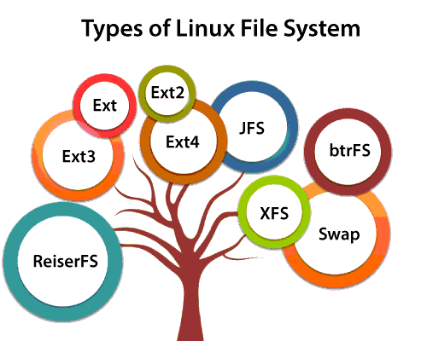
Linux Filesystems [8]
root filesystem: /
Linux Native Filesystems
ext2fs
ext3fs
ext4fs
ReiserFS
JFS
XFS
btrfs
[8] Non-Linux filesystems include FAT/FAT32, NTFS, HFS/HFS+, APFS, ISO-9660, and UDF.

Slide 14
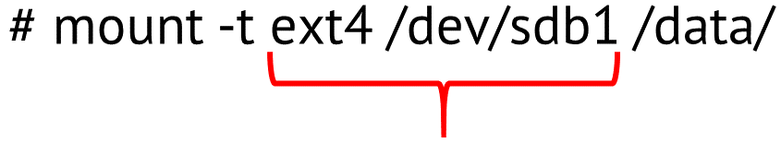
Working with Filesystems
The mount and umount commands
The /etc/fstab file
[8] Non-Linux filesystems include FAT/FAT32, NTFS, HFS/HFS+, APFS, ISO-9660, and UDF.

Slide 15
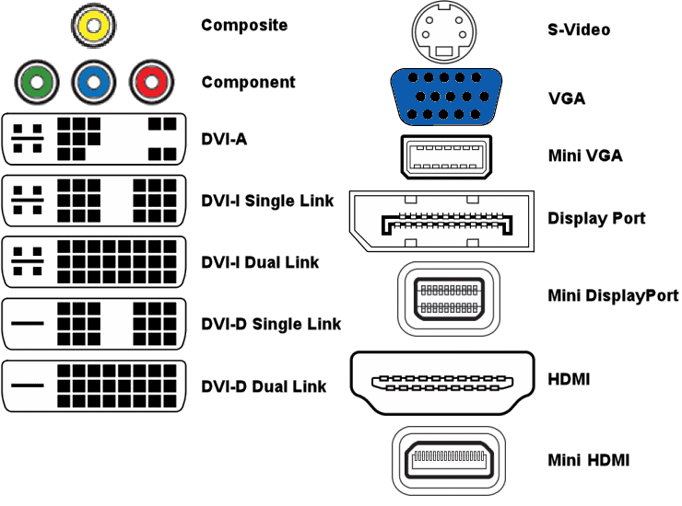
Managing Displays
Common Display connectors
HDMI
DVI
VGA
Linux auto-detects monitor optimum resolution

Slide 16
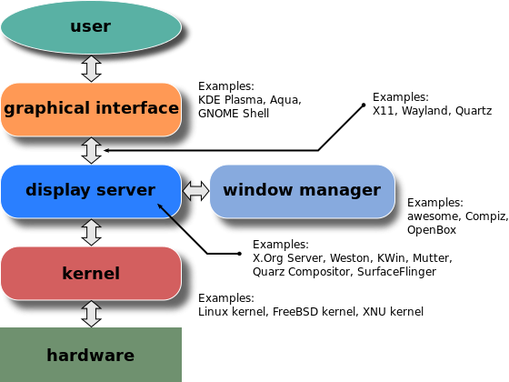
Managing Displays
Understanding the Role of X
If there is GUI, there is X server
Translates inputs to the kernel

Slide 17
Managing Displays
Steps in Managing a Display:
1: Initialize video (including resolution)
2: Allocate window sections to applications
3: Manage overlapping of windows and manage mouse
4: Direct user keyboard input to active application
5: Display text & shapes within windows
6: Provide user elements to move and resize windows
7: Manage elements (e.g., scroll bars)
X Window System handles steps 1-5, Window Manager handles steps 6,7

Slide 18
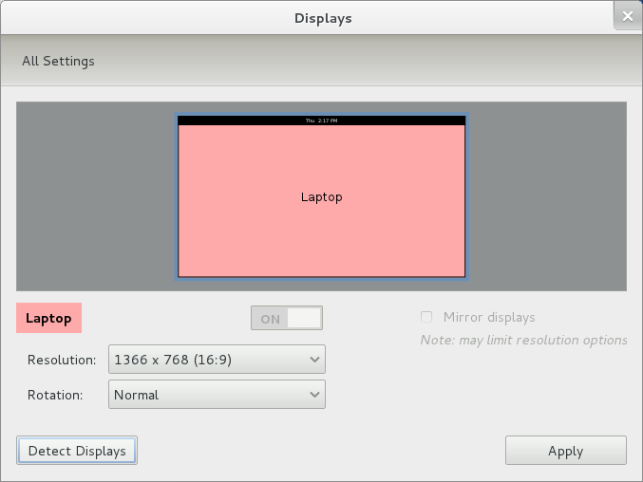
Managing Display Resolution with GUI Tools

Slide 19
Managing USB Devices
Human interface devices
Removeable/External disk storage
Mobile phones, cameras, ebook readers, music players
Scanners
Printers

Slide 20
The Role and Function of an Operating System
Application operation
Hardware mediator
Reliable data storage
Security
Network connectivity

Slide 21
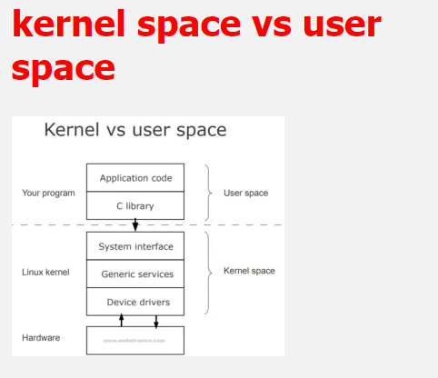
Managing Drivers
Understanding Types of Drivers
Drivers stored in the kernel
Drivers stored in library/applications
Locating and Installing Drivers
New hardware

Slide 22

Demos
Based on Red Hat Enterprise Linux (RHEL)
Oracle Linux is an open-source clone
Did You Know? Oracle’s Linux distro is a clone of RHEL and used in the Oracle Cloud Infrastructure (OCI).
Notes:
Commands (‘#’ denotes a comment):
uname –a
lscpu
lspci
cat /proc/cpuinfo
uname -r #check Linux kernel version
uname -s #check OS proper name
uname -a && cat /etc/*eleas* #get all detaisla bout the kernel, OS, and release notes
sudo lshw #get info on hardware
sudo lshw -html > lshw.html #send output to a nicely formatted html file
firefox lshw.html
sudo lscpu #get cpu info
sudo lspci #get pic device info
sudo lsusb #get usb device info
sudo lsblk -a #get drives info
sudo fdisk –l #get drives info
sudo dmidecode -t system #get kernel info
sudo dmidecode -t bios #get bios info
sudo dmidecode -t memory #get memory info
sudo dmidecode -t processor #get cpu info
sudo dmesg --follow #tail kernerl messages
sudo dmesg | grep -i usb #get messages on usb devices

Slide 23

Notes:
Interested?
• Contact the email address or connect via social media links at the bottom of the graphic
• Mention that you were referred by Dr. Galliano.

Slide 24

Notes:
Interested?
• Go to https://certs.comptia.org/fallscholarship/ and apply today!

Slide 25
What Questions Do you Have for Me?

